Slide 1
Modeling kernels

Slide 2






Kernels on the market
ACIS
Parasolid
CGM
C3D
RGK
SMLib
OpenCascade

Slide 3
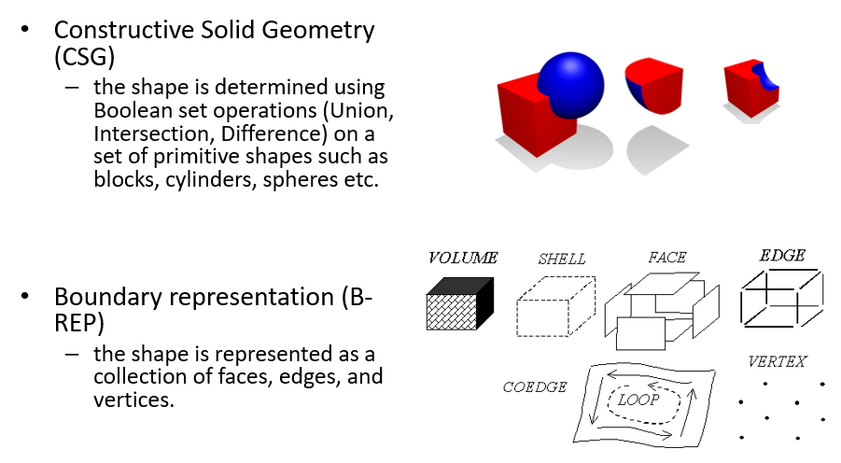
Exact reps

Slide 4
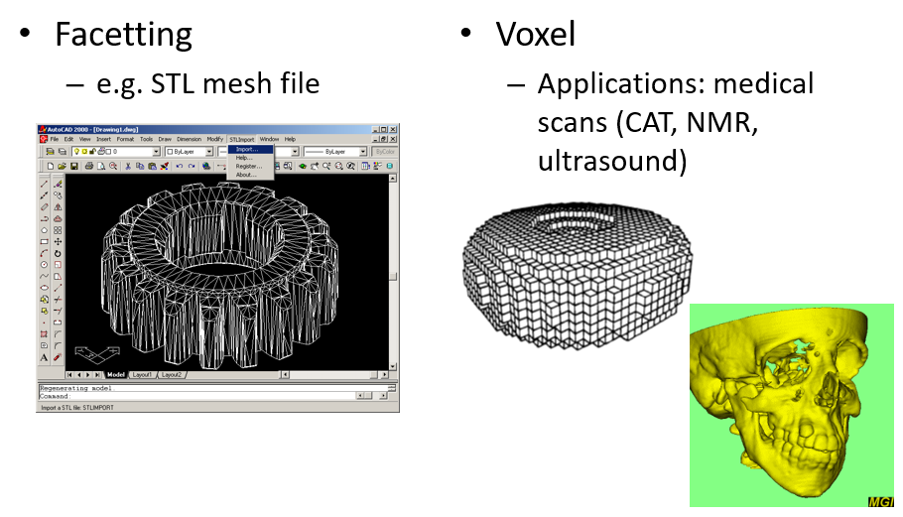
Inexact reps

Slide 5
ISO 10303, part 42
This part of ISO 10303 [part 42] specifies the resource constructs for the explicit geometric and topological representation of the shape of a product. The scope is determined by the requirements for the explicit representation of an ideal product model; tolerances and implicit forms of representation in terms of features are out of scope.

Slide 6
Why B-Rep?
Boundary modelers are currently dominating the CAD/CAM market. Why is it so? The short answer to this question as defined in [5]:
WYSIWYG: every EDGE and FACE displayed on the screen is explicitly held in the model’s data structure, making the editing and interrogation of objects straightforward. This may appear to be a trivial point but it makes the attachment of attributes, such as machining tolerances, to elements very easy.

Slide 7
But…
It is extremely hard to build a robust modeler. In general, the following criteria are used to assess every single algorithm:
Accuracy
Robustness
Efficiency
(*) Intelligence
Moreover, there should be ENOUGH algorithms to allow for general-purpose geometric modeling.

Slide 8
Meet OpenCascade

Slide 9
Meet OpenCascade
http://quaoar.su/blog/page/opencascade-overview

Slide 10
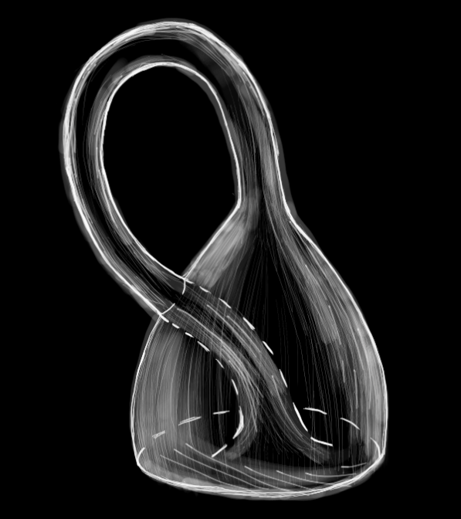
What is OpenCascade?
«Although there are facilities for displaying graphics in Open CASCADE, the real function of the library is to do the math.
There are dozens of graphics libraries (if not hundreds), but there are very few solid modeling libraries, and Open CASCADE is the only open source solid modeler.»
_{[COMMUNITY]}

Slide 11
Modules

Slide 12
Modules
or

Slide 13
Modules
or
Where to find what in the library?

Slide 14
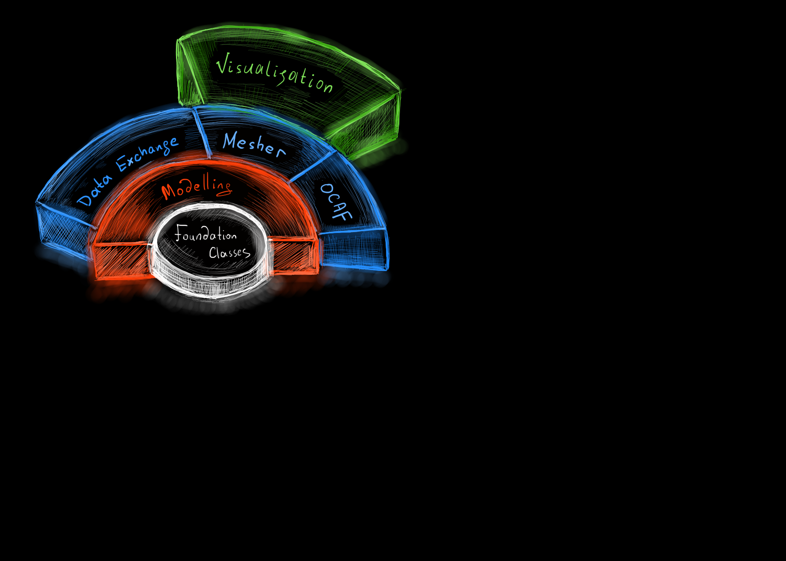

Slide 15
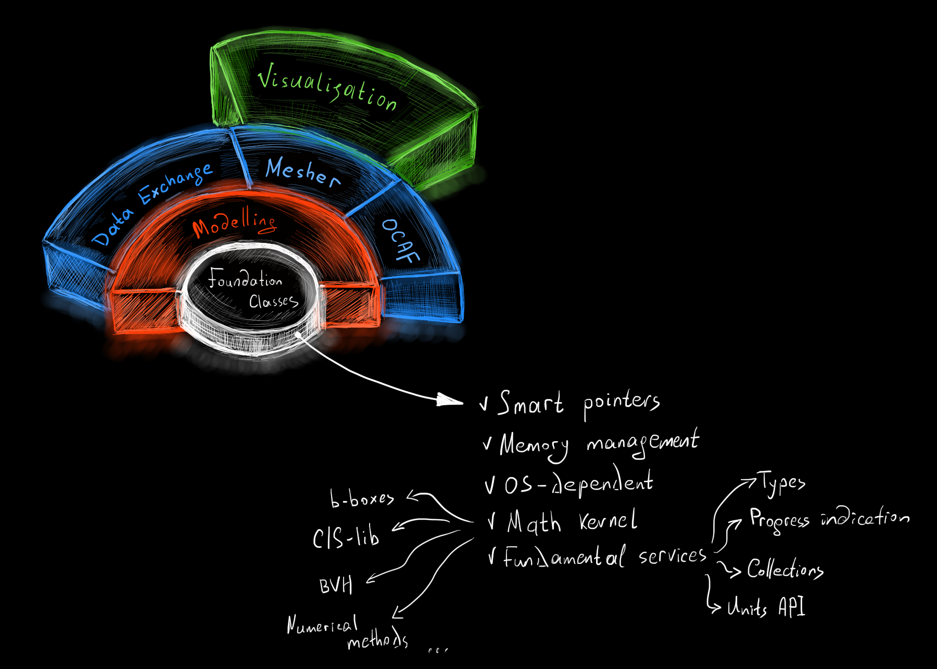

Slide 16
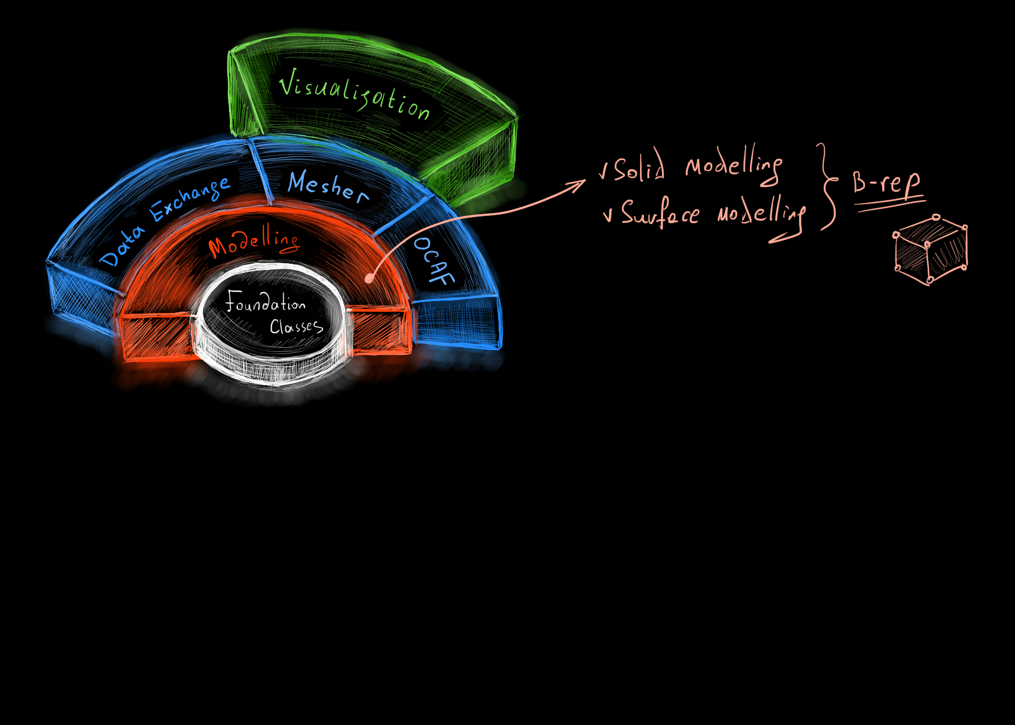

Slide 17
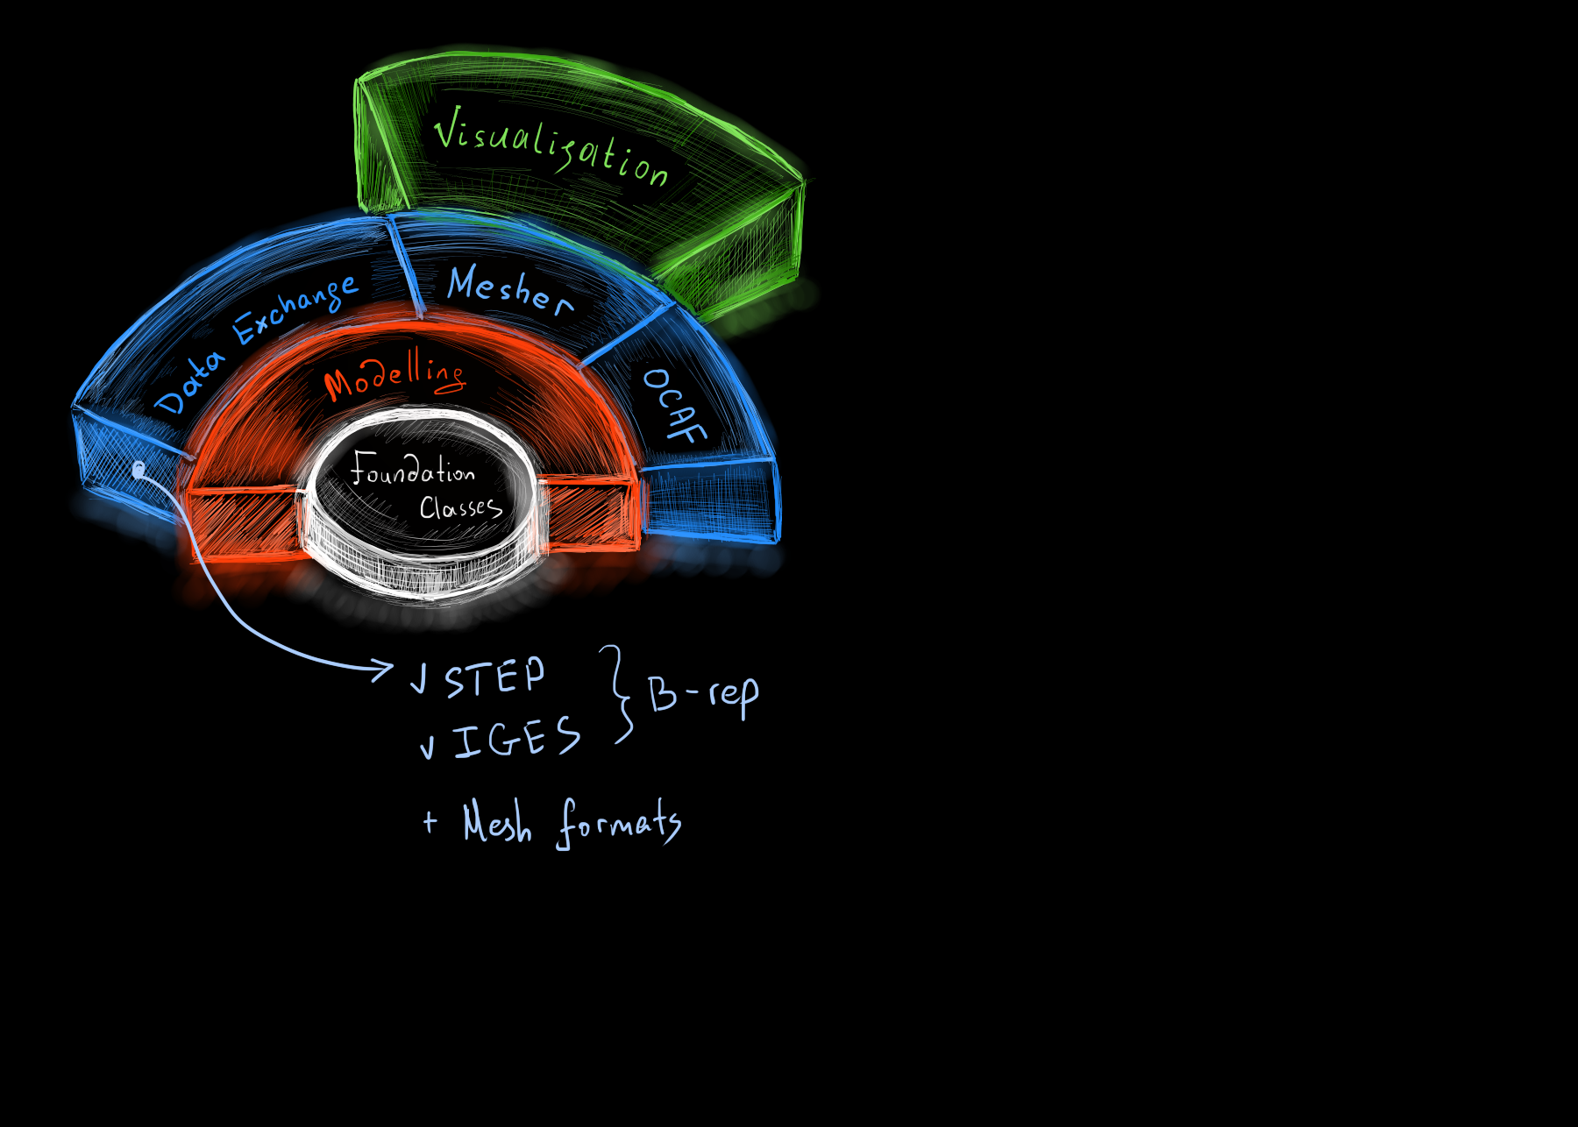

Slide 18
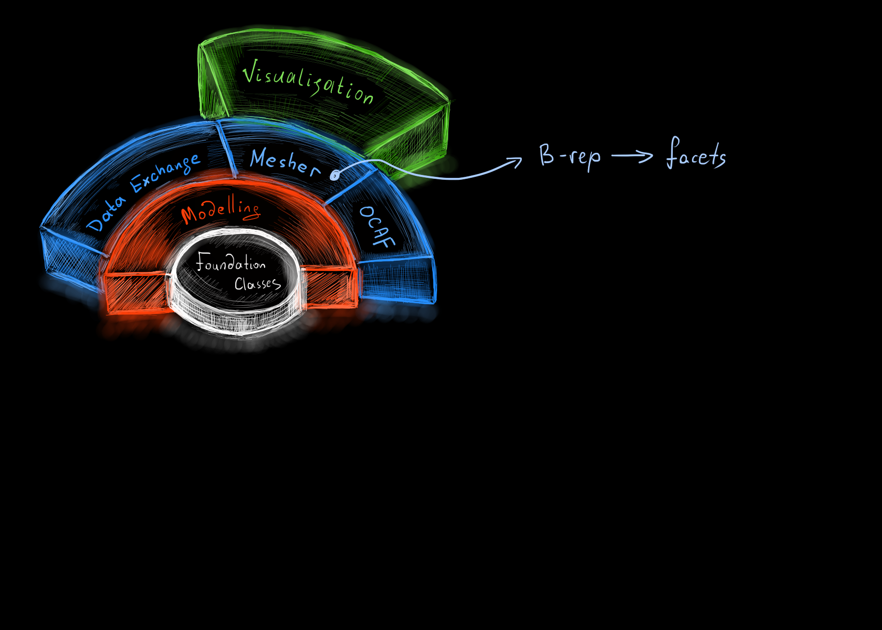

Slide 19
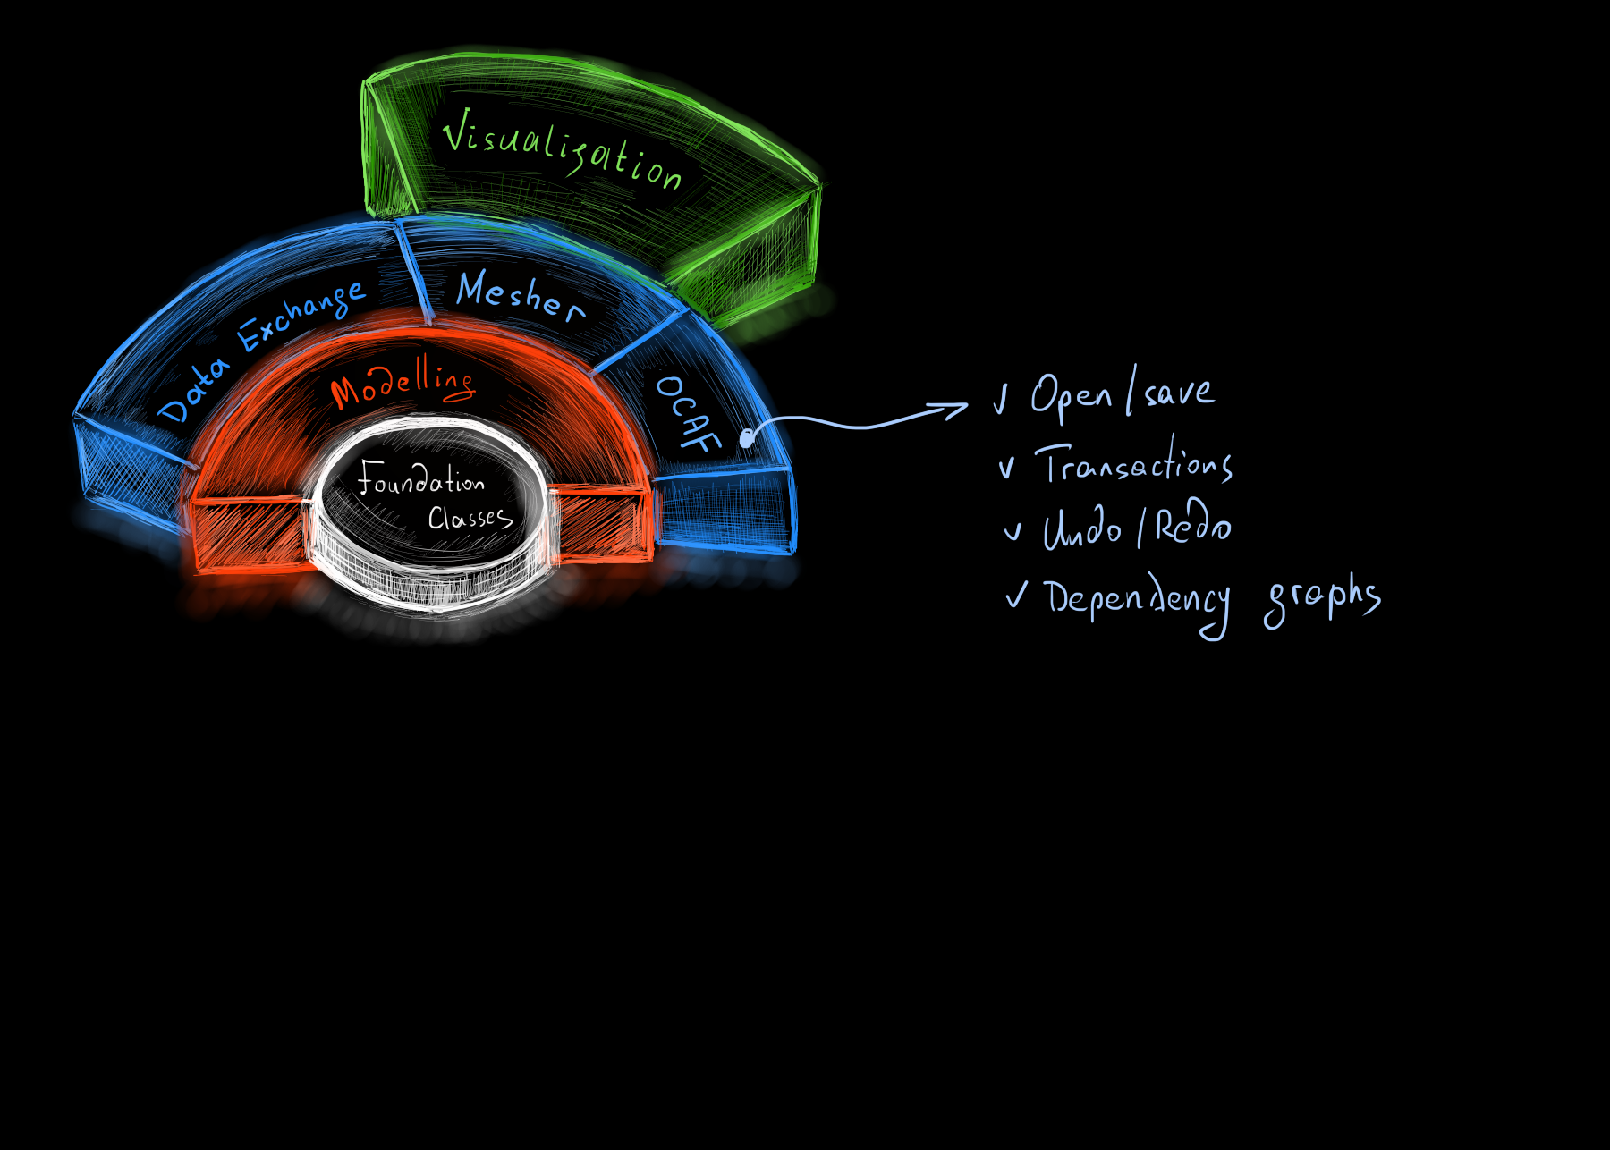

Slide 20
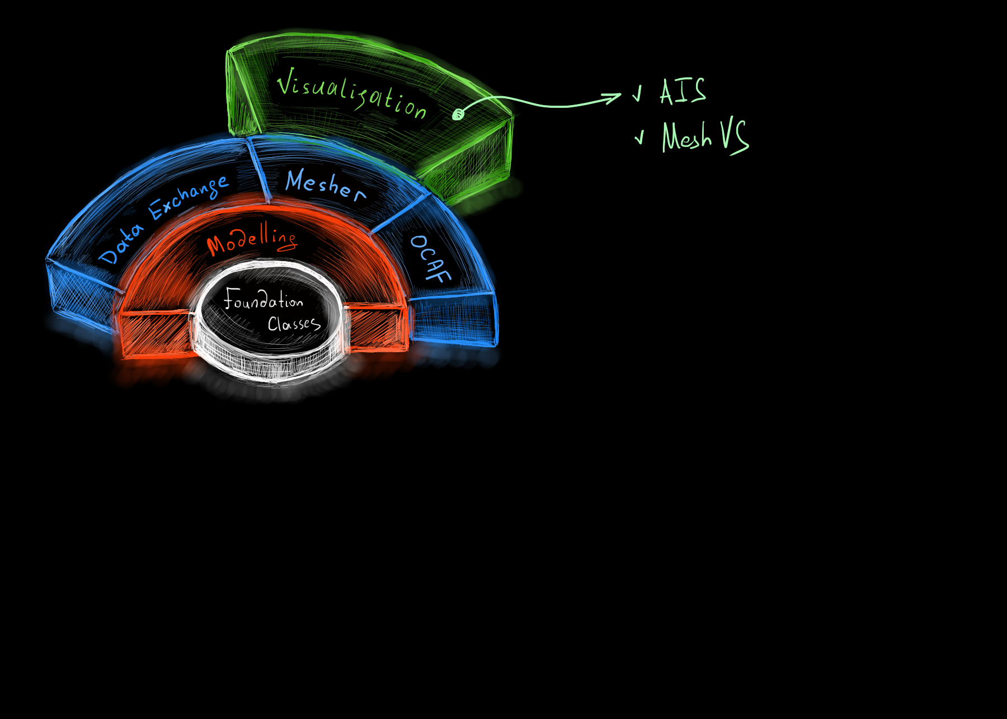

Slide 21
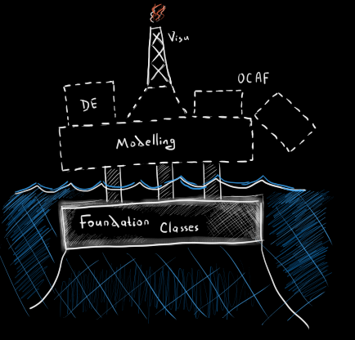
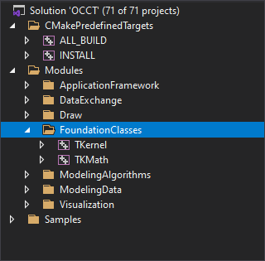
Foundation Classes

Slide 22
Foundation Classes // Math
Linear algebra

Slide 23
Foundation Classes // Math
Linear algebra
Solvers

Slide 24
Foundation Classes // Math
Linear algebra
Solvers
Eigen values & vectors

Slide 25
Foundation Classes // Math
Linear algebra
Solvers
Eigen values & vectors
SVD

Slide 26
Foundation Classes // Math
Linear algebra
Solvers
Eigen values & vectors
SVD
Optimization

Slide 27
Foundation Classes // Math
Linear algebra
Solvers
Eigen values & vectors
SVD
Optimization
Newton, BFGS, FRPR, Powell

Slide 28
Foundation Classes // Math
Linear algebra
Solvers
Eigen values & vectors
SVD
Optimization
Newton, BFGS, FRPR, Powell
PSO

Slide 29
Foundation Classes // Math
Linear algebra
Solvers
Eigen values & vectors
SVD
Optimization
Newton, BFGS, FRPR, Powell
PSO
Approximation and interpolation

Slide 30
Foundation Classes // Math
Linear algebra
Solvers
Eigen values & vectors
SVD
Optimization
Newton, BFGS, FRPR, Powell
PSO
Approximation and interpolation
By points or sections (discrete data)

Slide 31
Foundation Classes // Math
Linear algebra
Solvers
Eigen values & vectors
SVD
Optimization
Newton, BFGS, FRPR, Powell
PSO
Approximation and interpolation
By points or sections (discrete data)
By continuous function (e.g. from offset surface to polynomial)

Slide 32
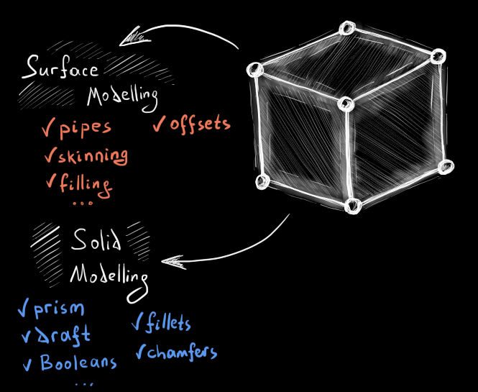

Modelling

Slide 33

Modelling

Slide 34
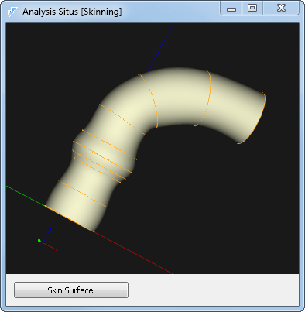

Modelling

Slide 35


Modelling

Slide 36



Modelling

Slide 37

Modelling

Slide 38

Modelling

Slide 39

Modelling

Slide 40


Modelling

Slide 41
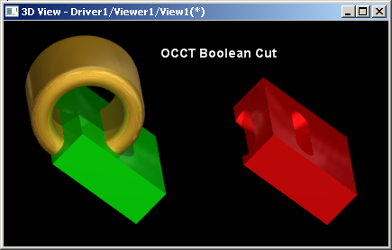
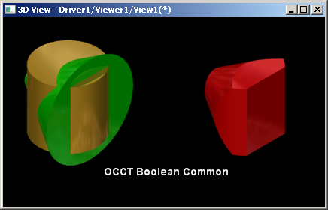


Modelling

Slide 42


Modelling

Slide 43
Modelling

Slide 44
Modelling

Slide 45
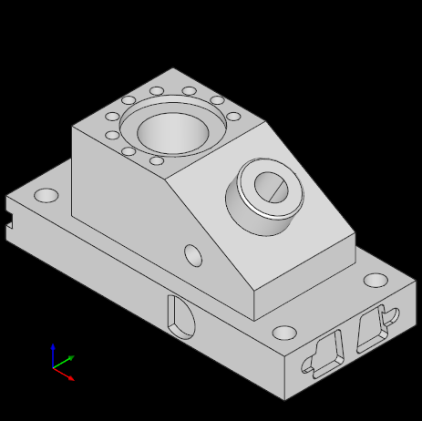
Mesher

Slide 46
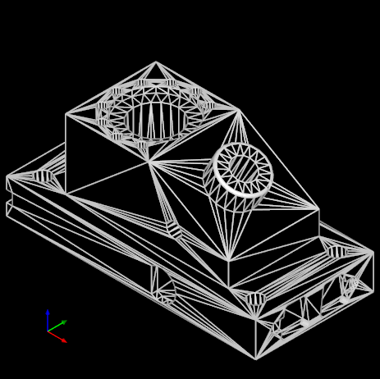
Mesher

Slide 47
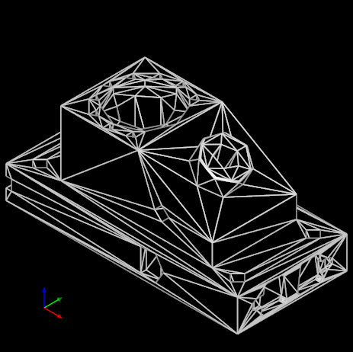
Mesher

Slide 48
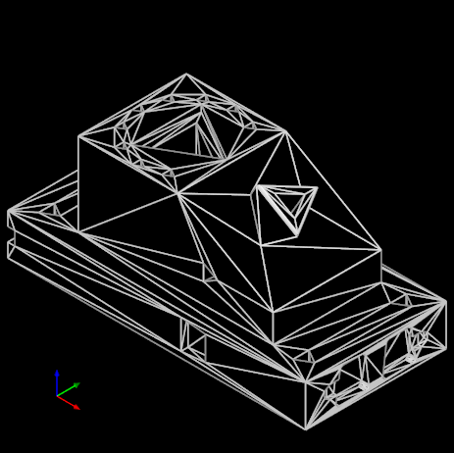
Mesher

Slide 49
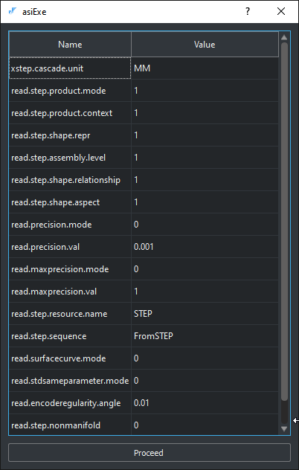
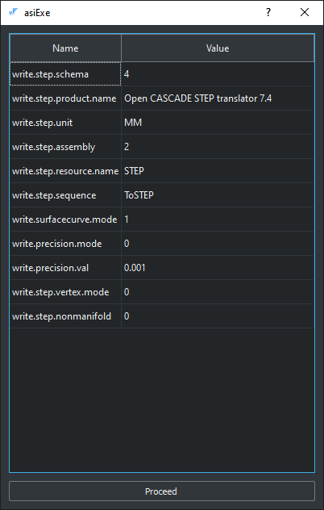
Data Exchange

Slide 50
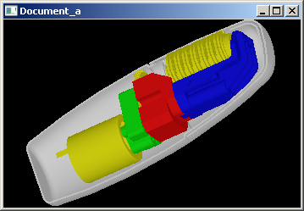
Data Exchange

Slide 51
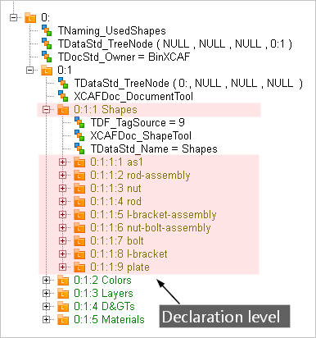
Data Exchange

Slide 52
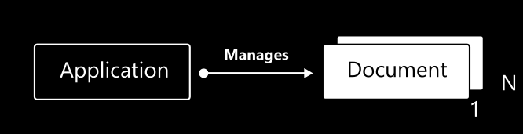
OCAF

Slide 53
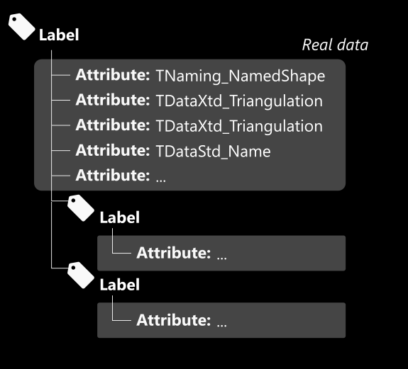
OCAF

Slide 54
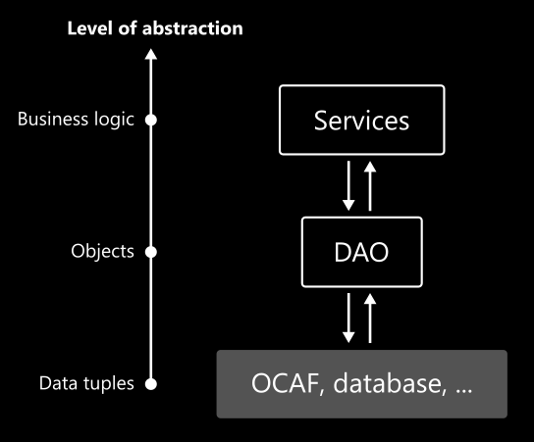
OCAF

Slide 55
Visualisation

Slide 56
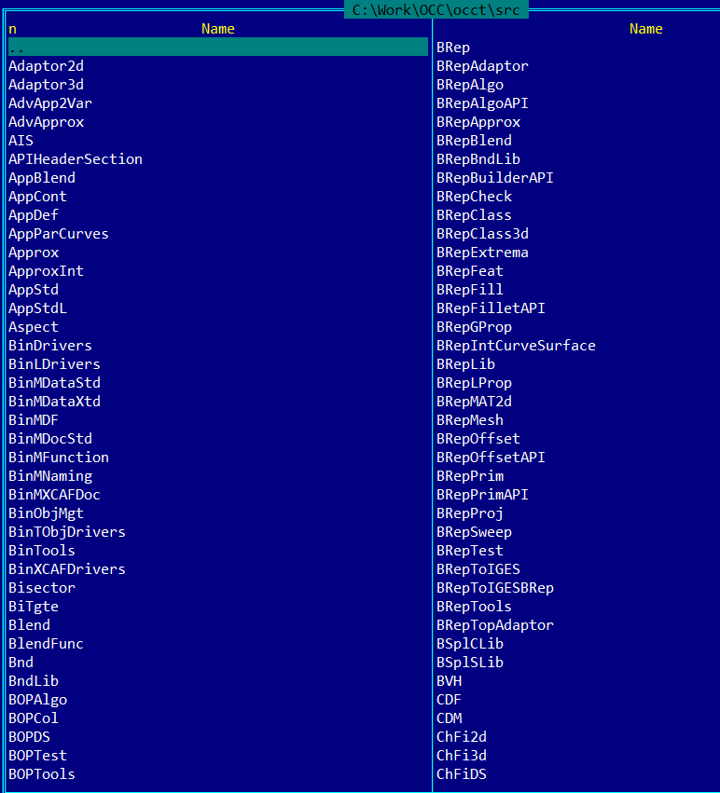
In the file system
Package 1 / Class 1
Package 1 / Class 2
Package 2 / Class 1
Package 2 / Class 2
…

Slide 57
More reading
An Introduction to Solid Modeling. M. Mantyla. 1988.
The NURBS Book. L. Piegl, W. Tiller.
Solid Modelling and CAD Systems. How to Survive a CAD System. I. Stroud. 2011.
Open Cascade Technology Overview // URL: http://quaoar.su/blog/page/opencascade-overview
3D Modelling with ACIS. Corney J.R., Lim T. 2001.

Slide 58
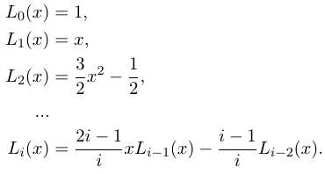
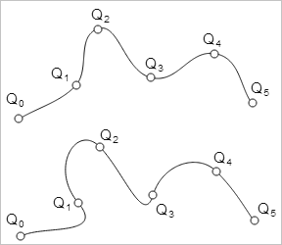
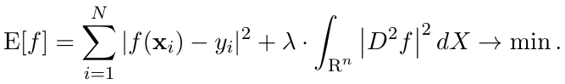
Math support
Linear algebra
Solvers
Eigen values & vectors
SVD
Optimization
Newton, BFGS, FRPR, Powell
PSO
Approximation and interpolation
By points or sections (discrete data)
By continuous function (e.g. from offset surface to polynomial)

Slide 59
Modeling
Surface
Kinematic surfaces
Skinning
…
Solid
Prism
Draft
Thin-walled solid
Booleans
…

Slide 60
Data exchange
Format:
Exact: STEP (ISO 10303), IGES
Polygonal: STL, VRML, OBJ, glTF
Data:
Geometry
Meta (assemblies, colors, names, attributes, etc.)

Slide 61
In filesystem
Package 1 / Class 1
Package 1 / Class 2
Package 2 / Class 1
Package 2 / Class 2
…

Slide 62
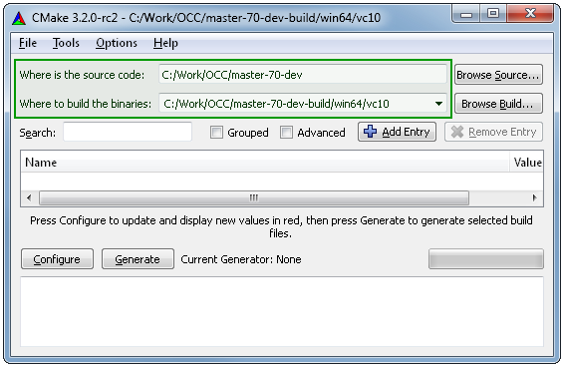
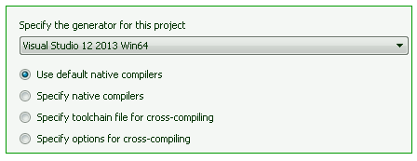
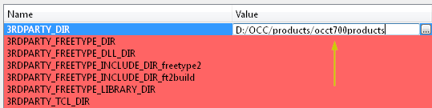
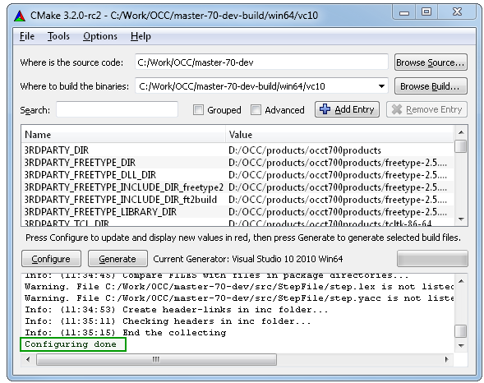
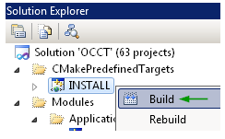
Build with CMake
2
1
4
3
5

Slide 63
Interesting reading
An Introduction to Solid Modeling. M. Mantyla. 1988.
The NURBS Book. L. Piegl, W. Tiller.
Solid Modelling and CAD Systems. How to Survive a CAD System. I. Stroud. 2011.
Open Cascade Technology Overview // URL: http://quaoar.su/blog/page/opencascade-overview
3D Modelling with ACIS. Corney J.R., Lim T. 2001.

Slide 64
Hello World

Slide 65
Entry point: Draw
Tcl interpreter with extensions
Access to the entire modeling API
Rapid prototyping

Slide 66
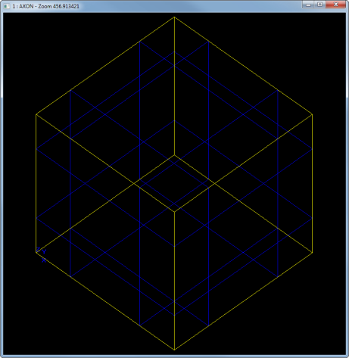
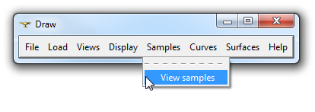
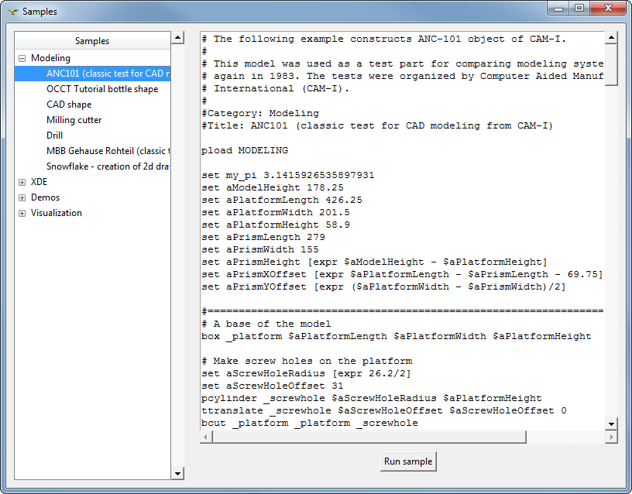
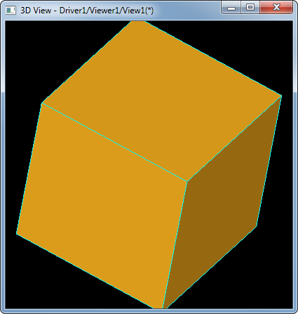
Basic commands
1
3
> pload ALL
> box a 1 1 1
> axo; fit
2
> vinit
> vdisplay a
>> f
>> s
>> Ctrl + RMB

Slide 67
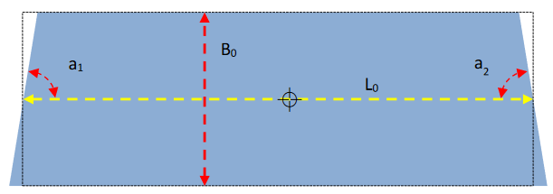
Prismatic block
proc buildBlock {resname L0 B0 a1Deg a2Deg height} {
global $resname
set Pi 3.1415926535897931
# Design variables.
set a1 [expr $a1Deg.*$Pi/180.]
set a2 [expr $a2Deg.*$Pi/180.]
set V1x [expr -$L0/2 - tan($a1)*$B0/2]
set V1y 0
set V2x [expr $L0/2 + tan($a2)*$B0/2]
set V2y 0
set V3x [expr $L0/2 - tan($a2)*$B0/2]
set V3y $B0
set V4x [expr -$L0/2 + tan($a1)*$B0/2]
set V4y $B0
# Build topology.
vertex V1 $V1x $V1y 0.
vertex V2 $V2x $V2y 0.
vertex V3 $V3x $V3y 0.
vertex V4 $V4x $V4y 0.
#
edge e1 V2 V1
edge e2 V1 V4
edge e3 V4 V3
edge e4 V3 V2
wire w e1 e2 e3 e4
mkplane f w
#
prism $resname f 0 0 $height
}
# pload ALL
# source C:/Work/lendlease/demo-ssv/create-block-01.tcl
# buildBlock b 130 60 20 45 30
# top; fit
V3
V4
V1
V2

Slide 68
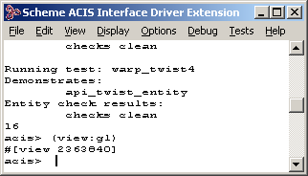
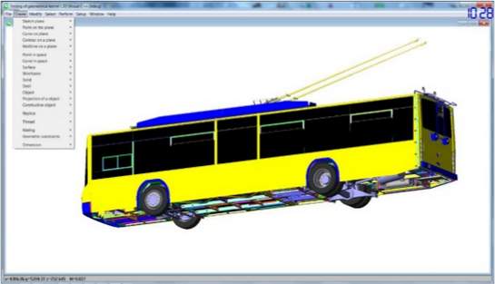
Similar things
ACIS Scheme AIDE
C3D Test Application
It is never a CAD-system, just a console or test app.

Slide 69
How to build a simple app?
Options
Your main() function // No visualization
Executable with Draw // .exe
Plugin for Draw // .dll

Slide 70
Understanding B-rep

Slide 71
Geometry vs Topology
“To solve many of geometric problems we do not need to know spatial information but what is required to be known is neighborhood or connectivity information termed as topology.” Sandip Jadhav

Slide 72
ISO 10303-42 says
The geometry … is exclusively the geometry of parametric curves and surfaces. It includes the curve and surface entities and other entities, functions and data types necessary for their definition. A common scheme has been used for the definition of both two-dimensional and three-dimensional geometry.
The topology … is concerned with connectivity relationships between objects rather than with the precise geometric form of objects. This clause contains the basic topological entities and specialised subtypes of these. In some cases the subtypes have geometric associations. Also included are functions, particularly constraint functions, and data types necessary for the definitions of the topological entities.

Slide 73
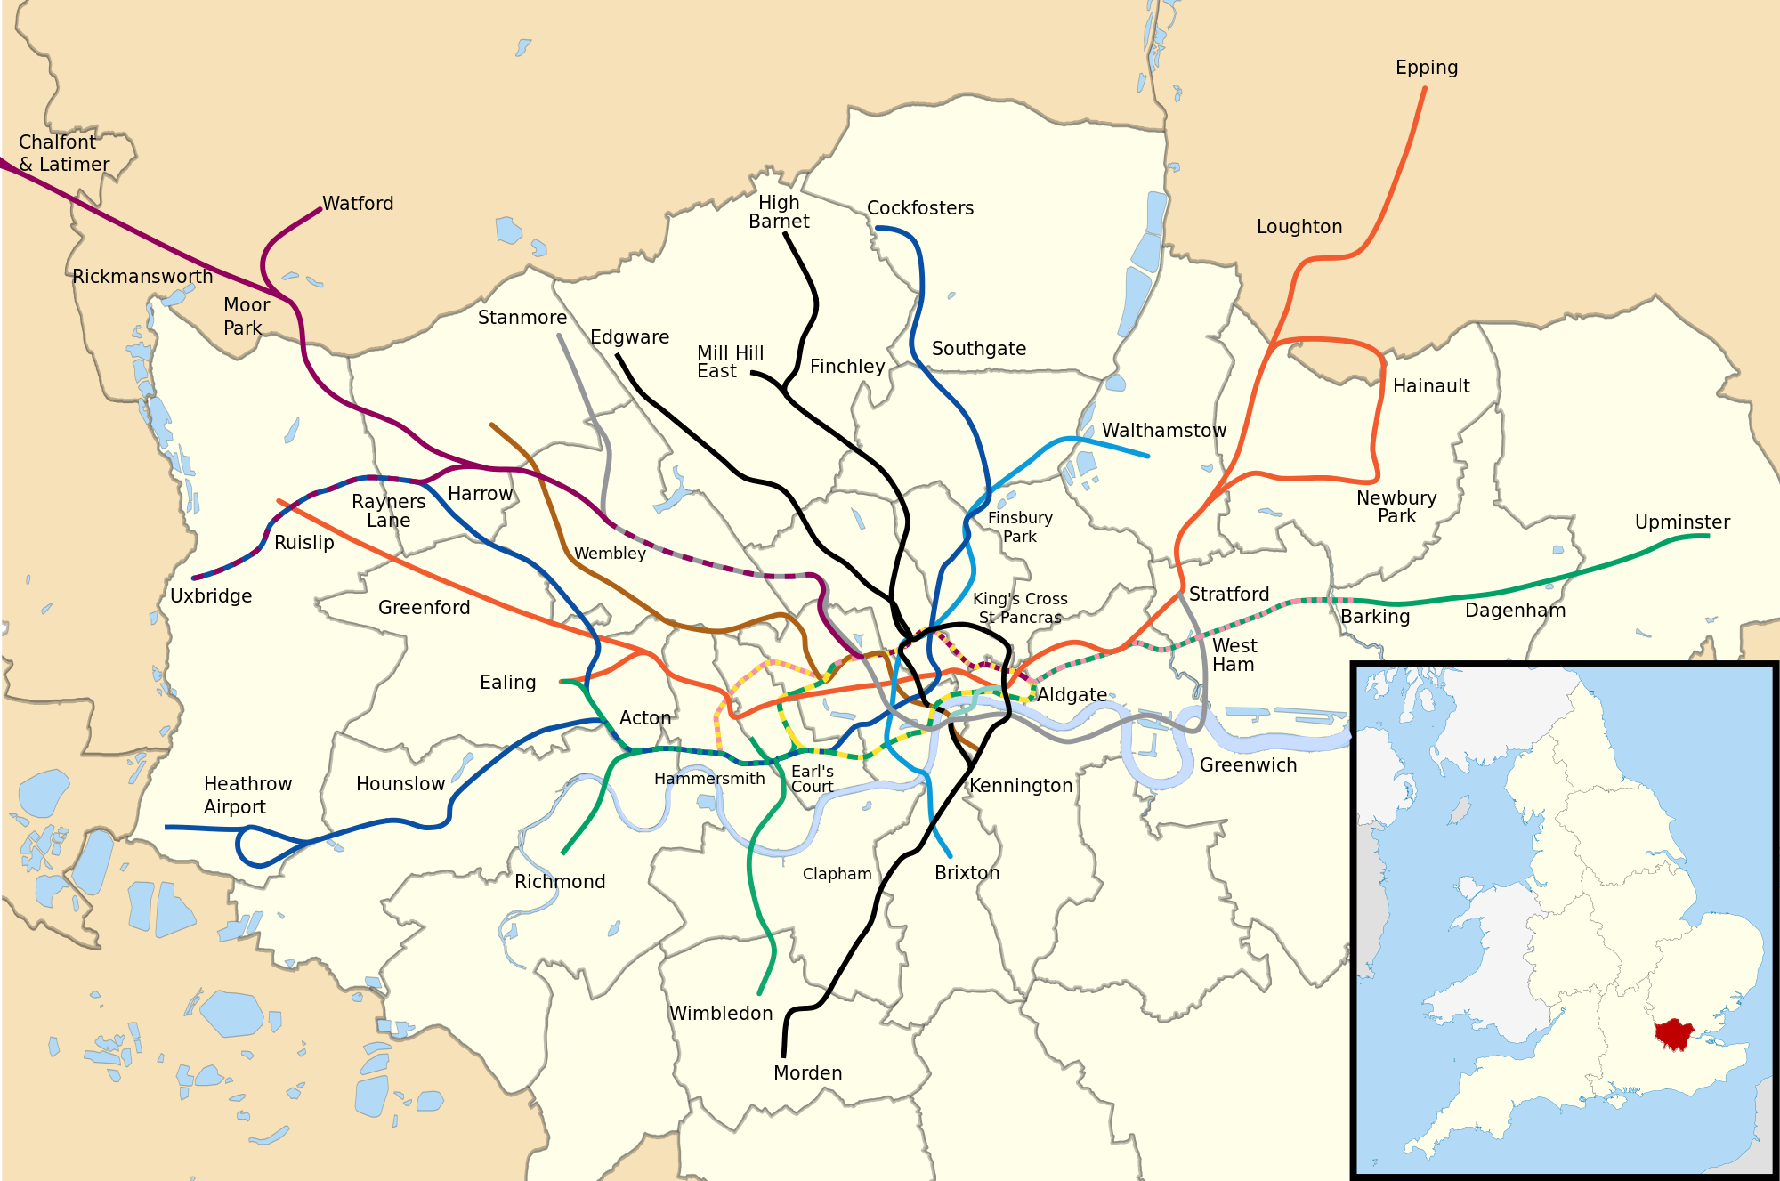

Geometry vs Topology

Slide 74
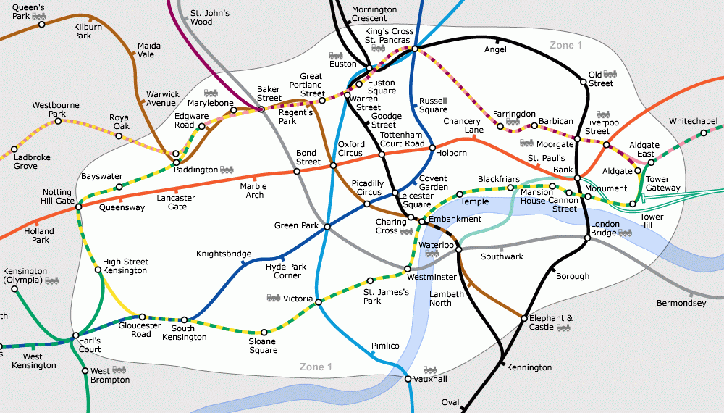
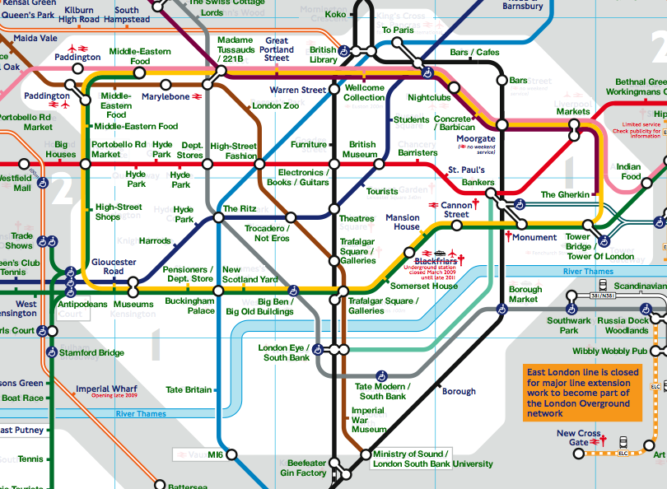
Geometry vs Topology
Geometry = real locations
Topology = connections

Slide 75
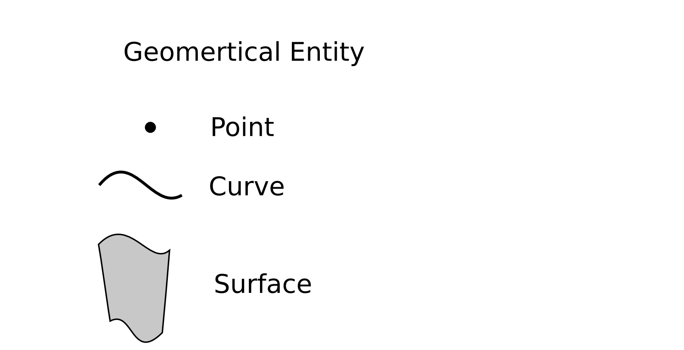
Geometry vs Topology

Slide 76
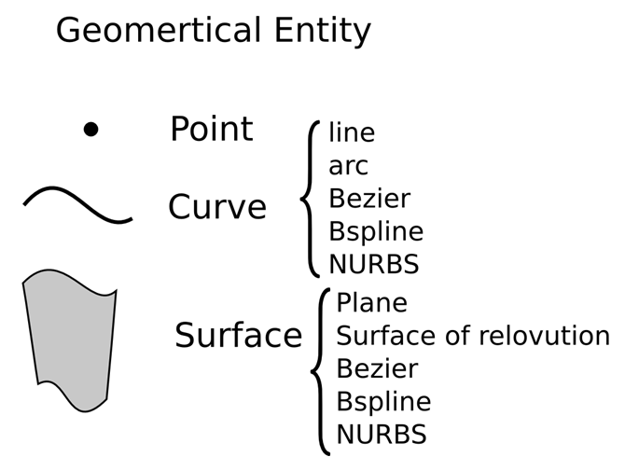
Geometry vs Topology

Slide 77
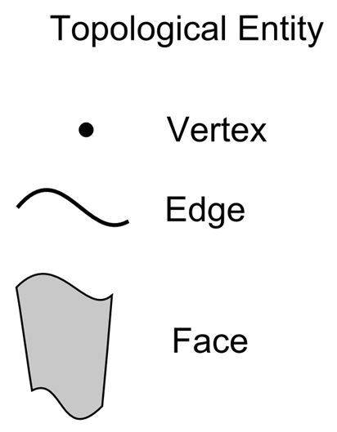
Geometry vs Topology

Slide 78
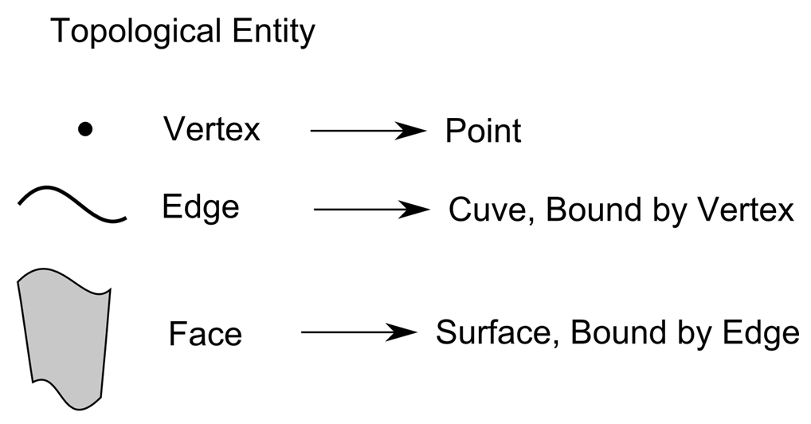
Geometry vs Topology

Slide 79

Geometry vs Topology

Slide 80

Geometry vs Topology

Slide 81

Geometry vs Topology

Slide 82

Geometry vs Topology

Slide 83
Geometry vs Topology
VERTEX
FACE
EDGE

Slide 84
Реализация в OpenCascade
Geom
TopoDS
Geom2d

Slide 85


OpenCascade vs ACIS

Slide 86
Assemblies and data exchange

Slide 87

Assemblies
Geometry: TopoDS
Assemblies and meta: XDE/OCAF

